Slide 1

CFS Forum:
Financial Literacy Touchpoints

Slide 2

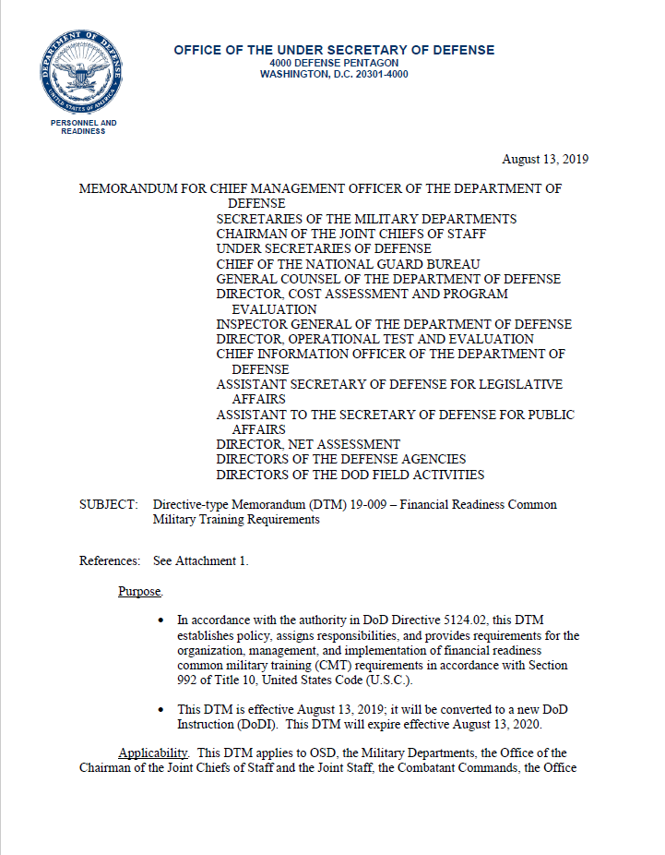
National Defense Authorization Act of 2016
DTM 19-009 Financial Readiness Common Military Training Requirements – August 13, 2019
2

Slide 3

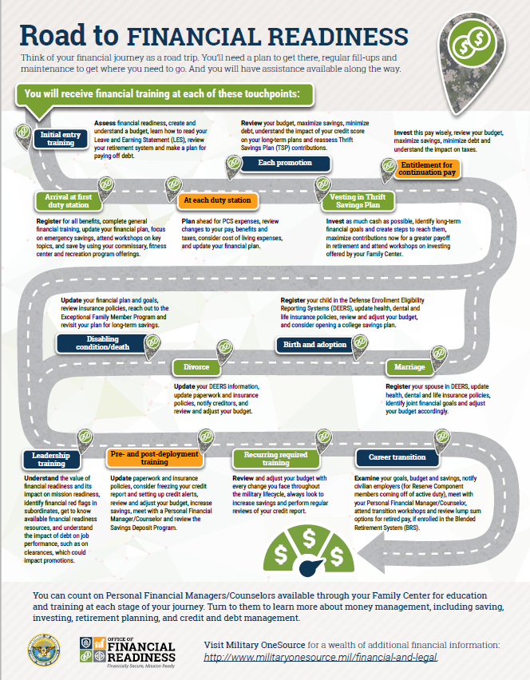
What are the Touchpoints?
Initial Entry Training
First Duty Station
PCS Moves
Promotion
Vesting in TSP
Entitlement for Continuation Pay
Disabling condition
Divorce
Birth/Adoption
Marriage
Leadership Training
Pre and Post Deployment
Career Transition
3

Slide 4


NSIPS Notification
Service member will be directed to see their CFS or PFM at FFSC for assistance. Must have current address in NSIPS.
4

Slide 5

Completing Touchpoint Training
Service member can attend the required financial classes offered at FFSC.
Service member can meet individually with a CFS or PFM to complete the touchpoint checklist.
Video options to complete trainings coming in May 2020 and online through Navy eLearning Oct 2020
Instructor Guide and Slide options available in Oct 2020
5

Slide 6
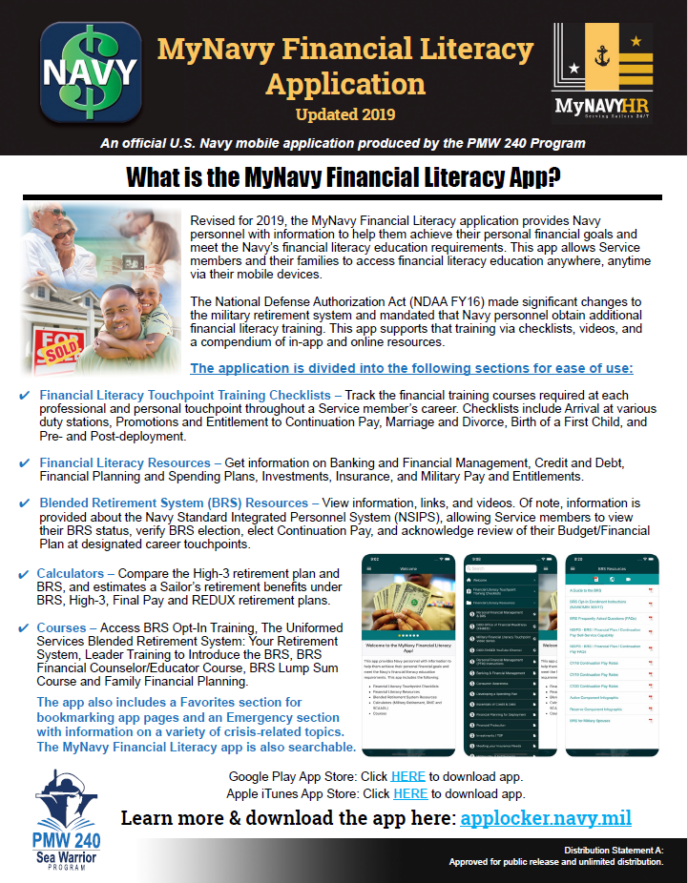
Option 1: FFSC Financial Classes
Navy Financial Literacy App –find the required financial classes for each touchpoint.
Service member obtain a certificate of completion from FFSC.
Service member provides certificate to training department at command - FLTMPS entry.
If needed, update budget with PFM/CFS and record completion in NSIPS.
6

Slide 7
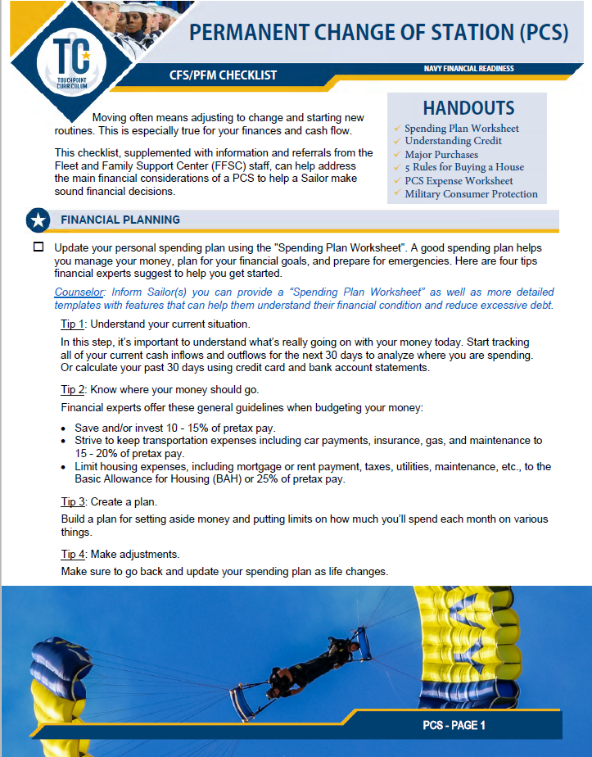
Option 2:Touchpoint Checklist 1:1
CFS/PFM uses checklist to complete training requirements with Service member.
CFS/PFM and Service member sign and date the checklist.
Service member provides signed checklist to training department at command for FLTMPS entry.
If required, update budget with PFM/CFS and record completion in NSIPS.
7

Slide 8


PFM Name
Title
Location
Phone
email
The appearance of U.S. Department of Defense (DoD) visual information does not imply or constitute DoD endorsement.

