Slide 1

PFM Leadership Forum Date

Slide 2

Welcome and Introductions of PFM Team
2

Slide 3

Agenda
CFS Qualifications
CFS Refresher Qualifications
Financial Literacy Touchpoints
Interactive Session for CFS
3

Slide 4

CFS Qualifications
E-6 and above (including officers)
One year remaining at the Command
Highly motivated and financially stable
Successfully complete CFS Training
Participate in continuing education
Complete CFS Refresher Training (3 years)
4

Slide 5


CFS Tasks
Assessment of Command Needs
Financial Education and Training
Information and Referral Resources
Financial Counseling
Record-Keeping
Client Monitoring and Follow-Up
5

Slide 6
CFS Refresher Requirements
Complete CFS Refresher Training before original certification expires (3 years)
Quarterly Reports – counseling/training provided
Continuing Education*
*CFS must provide documentation as proof and must be verified by a PFM at FFSC BEFORE they will be registered for CFS Refresher Training
6

Slide 7
CFS Refresher Requirements
COVID-19 Updates:
  All CFS whose CFS certification would expire between 1 February 2020 and 30 September 2020 can complete the 1-Day CFS Refresher course to renew their certification by 30 November 2020 as long as they have met all of the prerequisites for the 1-Day CFS Refresher before starting the course.
6

Slide 8
Quarterly Reports
One-on-one Financial Counseling
Provide Financial Trainings to the Command
*Minimum of 4 activities per quarter*
7

Slide 9
Continuing Education
Attend CFS Forums – 2 per year
If cannot attend CFS Forum other options to fulfill this requirement are:
  Financial class offered at FFSC
  Financial webinar offered through CNIC-LMS
  Financial webinar offered through Military Families Learning Network that is pre-approved for AFC CEUs at https://militaryfamilieslearningnetwork.org
3

Slide 10
Issues We are Seeing
People taking CFS class that don’t intend to be a CFS at the Command
People taking the class that should not be a CFS (not financially stable)
CFS’s not qualifying for CFS Refresher – not doing Quarterly Reports
CFS registration online
CFS’s walking in to CFS Refresher class
E-5 Waivers and class registration
3

Slide 11
Financial Literacy Touchpoints

Slide 12
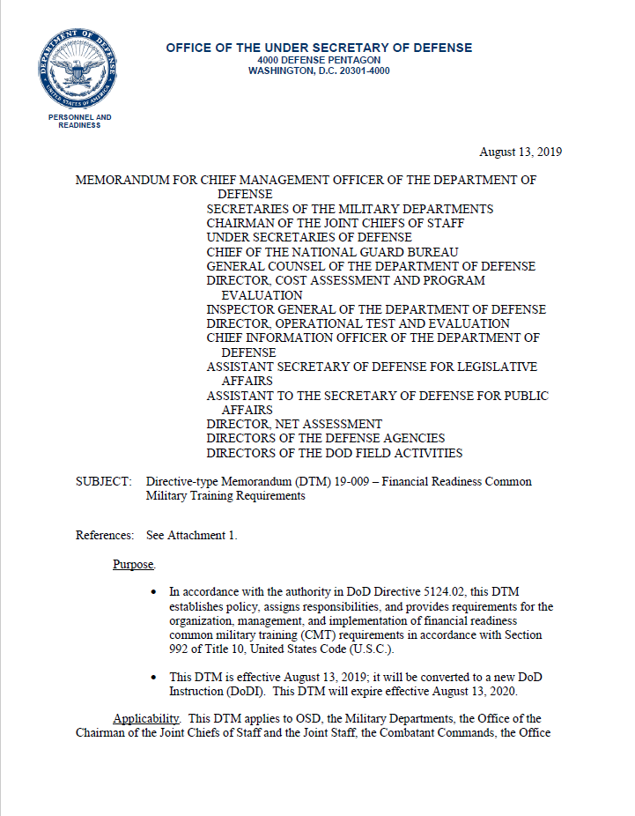
National Defense Authorization Act of 2016
DTM 19-009 Financial Readiness Common Military Training Requirements
August 13, 2019
2

Slide 13
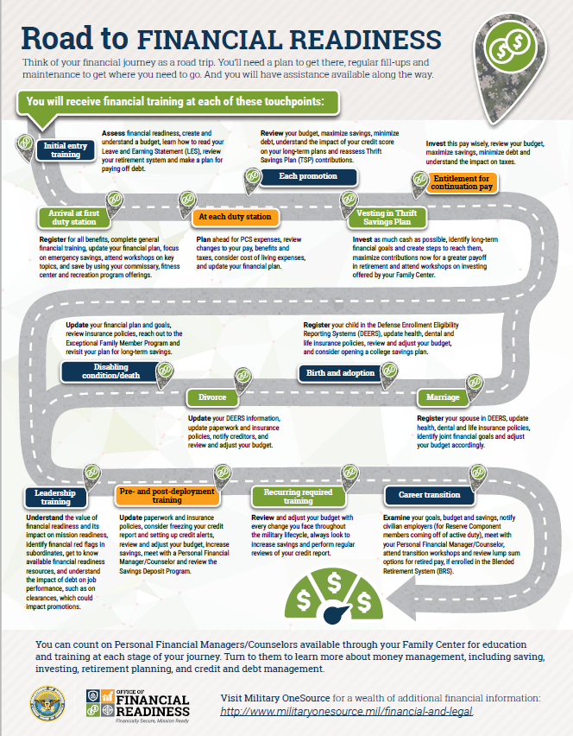
What are the Touchpoints?
Initial Entry Training
First Duty Station
PCS Moves
Promotion
Vesting in TSP
Entitlement for Continuation Pay
Disabling condition
Divorce
Birth/Adoption
Marriage
Leadership Training
Pre and Post Deployment
Career Transition
3

Slide 14
NSIPS Notification
Service member will be directed to see their CFS or PFM at FFSC for assistance. Must have current address in NSIPS.
4

Slide 15
Completing Touchpoint Training
Service member can attend the required financial classes offered at FFSC.
Service member can meet individually with a CFS or PFM to complete the touchpoint checklist.
Video options to complete trainings coming in May 2020 and online through Navy eLearning Oct 2020
Instructor Guide and Slide options available in Oct 2020
5

Slide 16
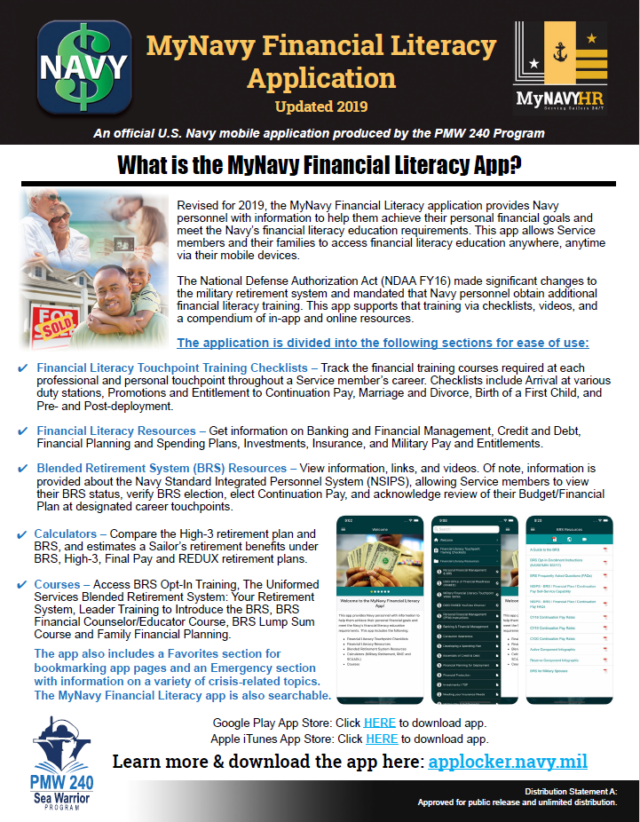
Option 1: FFSC Financial Classes
Navy Financial Literacy App –find the required financial classes for each touchpoint.
Service member obtain a certificate of completion from FFSC.
Service member provide certificate to training department at command - FLTMPS entry.
If required, update budget with PFM/CFS and record completion in NSIPS.
6

Slide 17
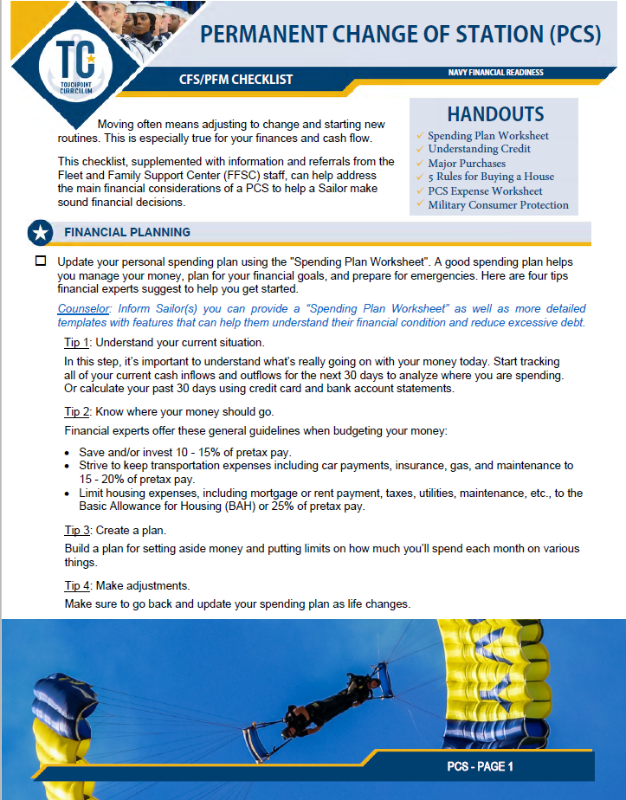
Option 2: Touchpoint Checklist 1:1
CFS/PFM uses checklist to complete training requirements with Service member.
CFS/PFM and Service member sign and date the checklist.
Service member provides signed checklist to training department at command for FLTMPS entry.
If required, update budget with PFM/CFS and record completion in NSIPS.
7

Slide 18


PFM
Title
Location
Phone
email
The appearance of U.S. Department of Defense (DoD) visual information does not imply or constitute DoD endorsement.

